Slide 1
Artificial Intelligence
History

Slide 2

Definition of AI
Many, many, many different definitions of AI
Pretty good one:
‘Theory and development of technology able to perform tasks normally requiring human intelligence’

Slide 3
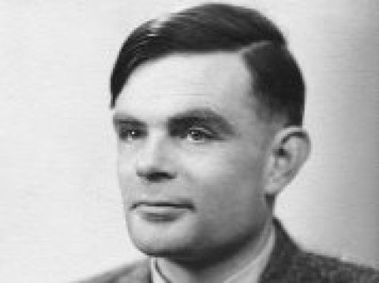
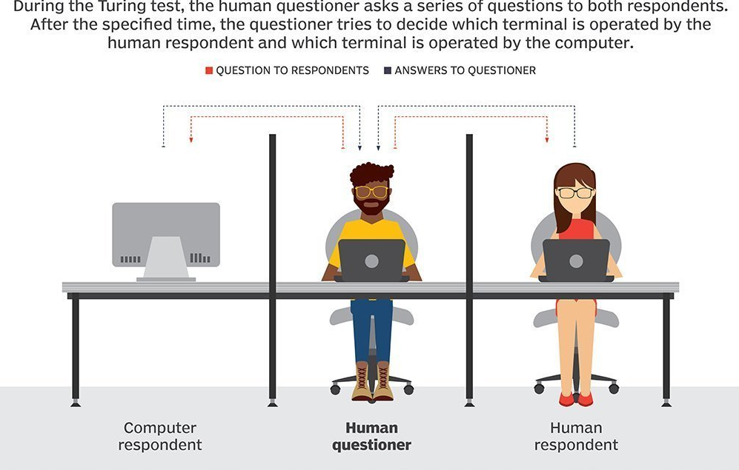
Turing Test

Slide 4
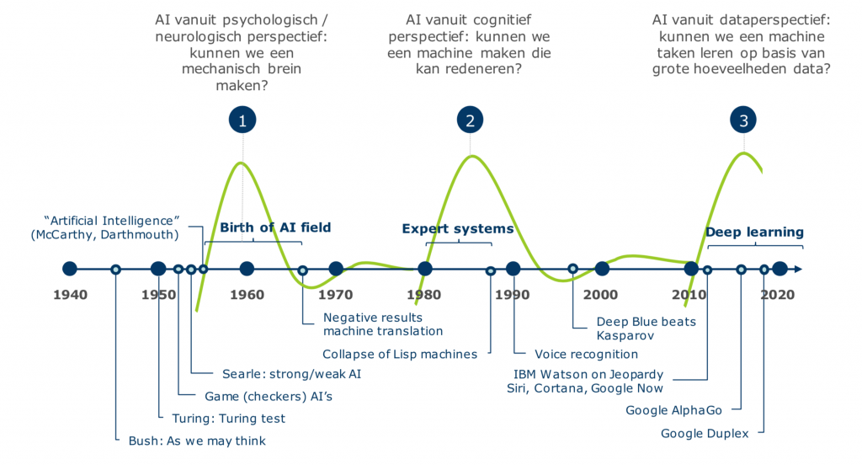
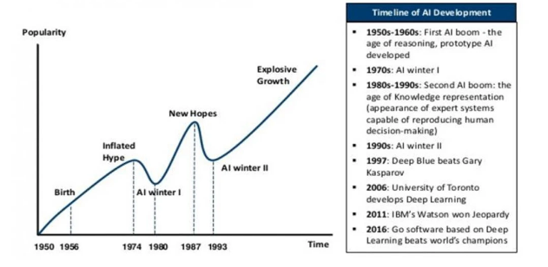
History of AI

Slide 5
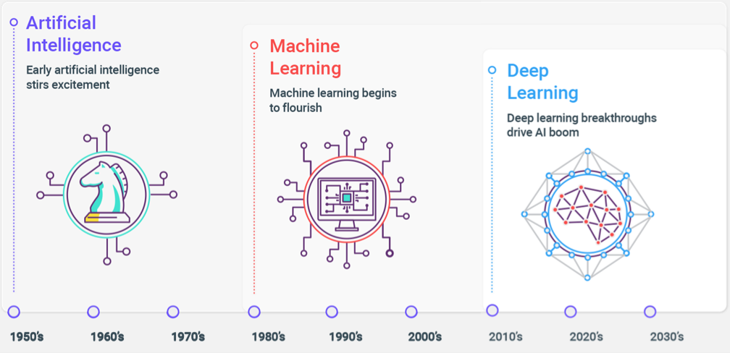
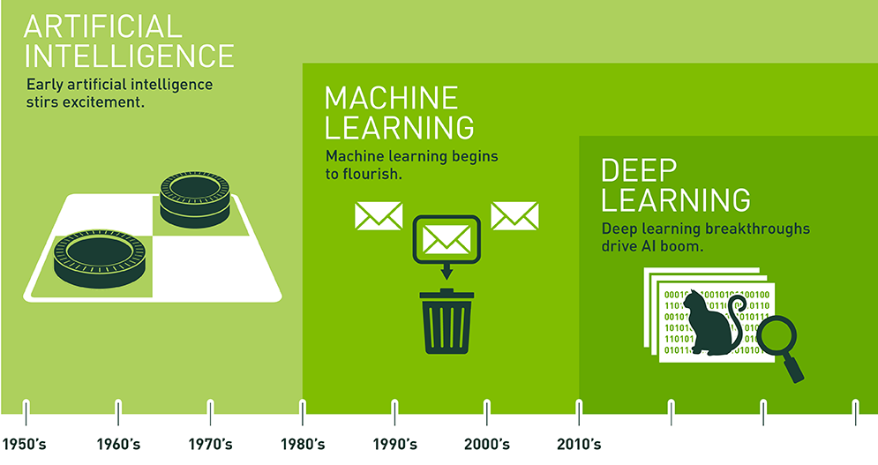
History of AI

Slide 6
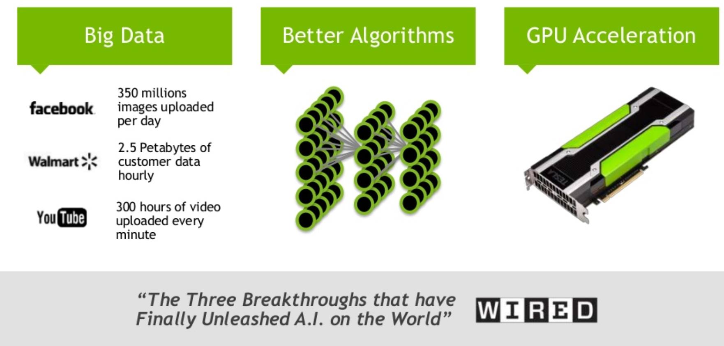
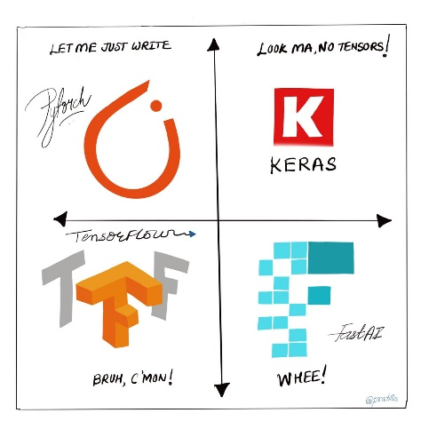
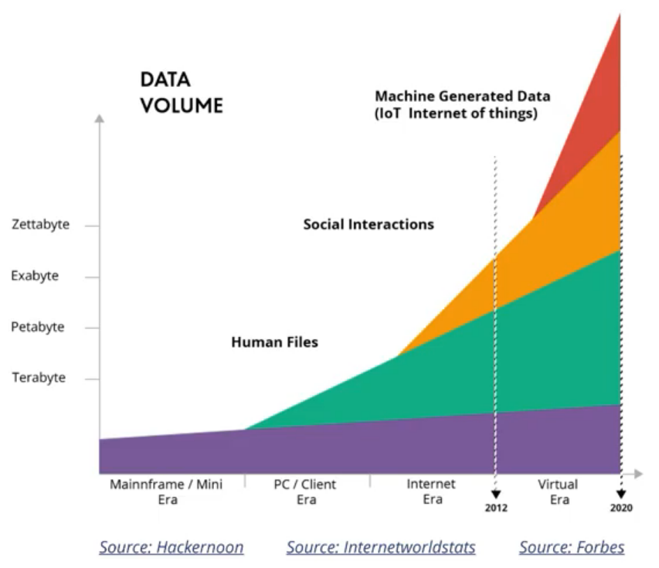
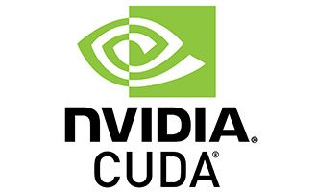
Why is Deep Learning booming only now?

Slide 7
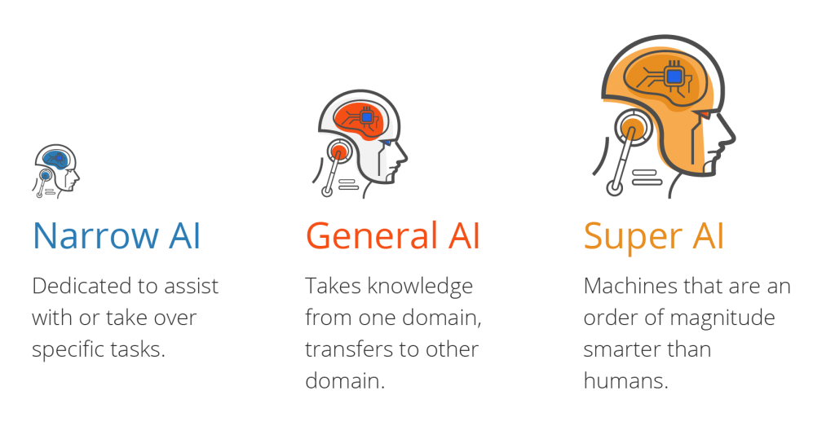
Types of AI

Slide 8
Artificial Intelligence
Recursion

Slide 9
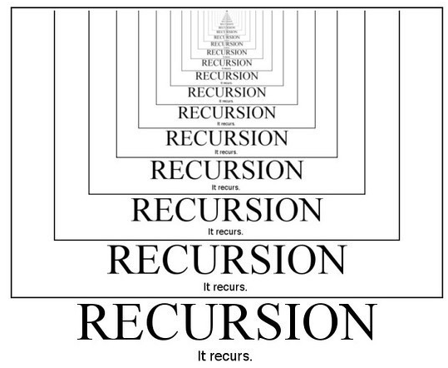
Recursion
Mindbender!
‘An elegant way to solve complex problems with code, and it’s still being used under the hood, in a lot of AI algorithms, ranging from path finding code, to decision trees, all the way to backpropagation of a neural network’

Slide 10
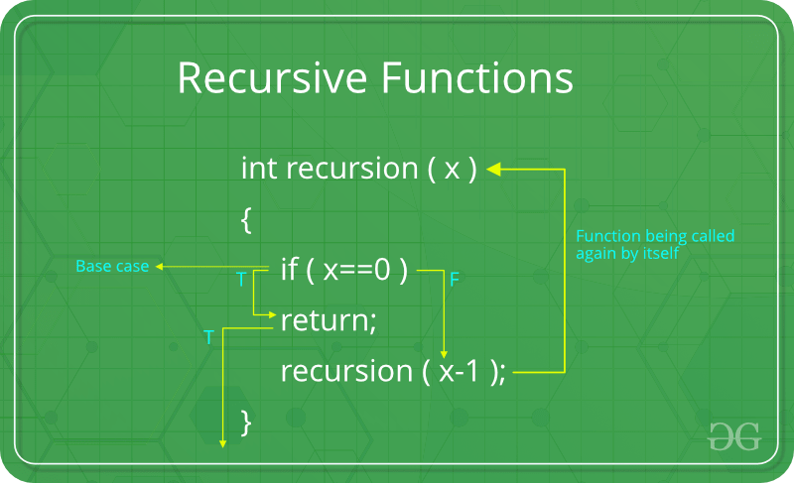
Problem statement:
‘Write a program to count all the files in a folder, but… there might also be folders inside those folder containing files and possibly other folders, which also possibly contain files and folders, which…’
An iterative approach to solve this:
Loops, in loops, in loops, in loops, etc
→ really hard to troubleshoot and design, but conceptually easy to grasp
Another way is to use a recursive function:
a function that keeps on calling itself, until
a stopping condition is met

Slide 11
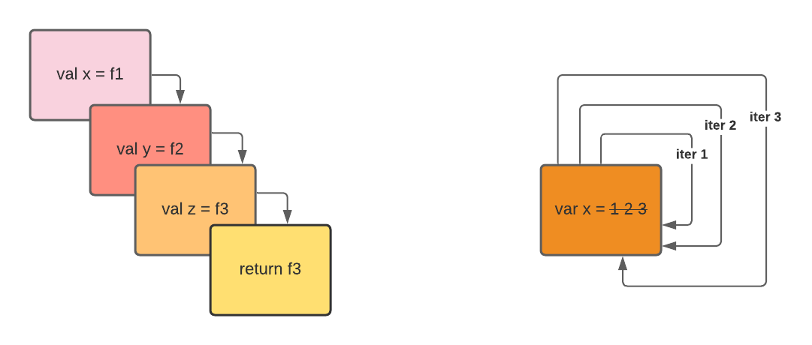
Recursive >< Iterative

Slide 12
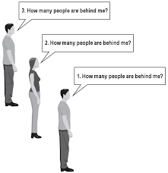
Another example
Count how many people are behind you in a long row, recursively:
if there is nobody behind me
I will answer 0
if there is someone behind me
ask him/her how many people are behind him/her
when they respond with a value N, then I will answer N + 1

Slide 13
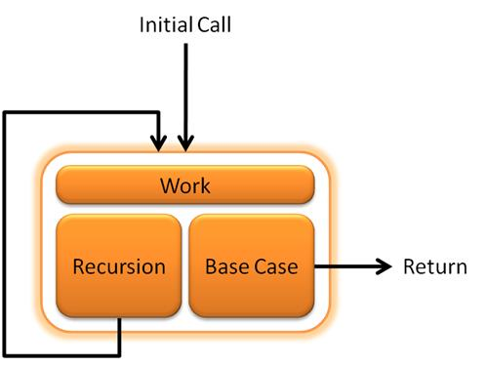
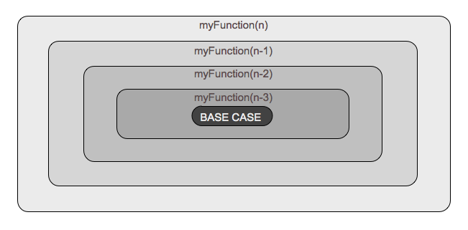
Base case & recursive case

Slide 14
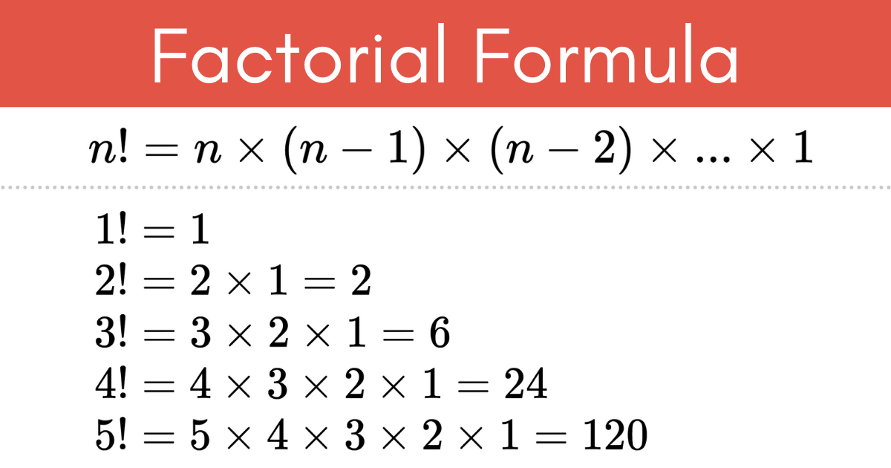
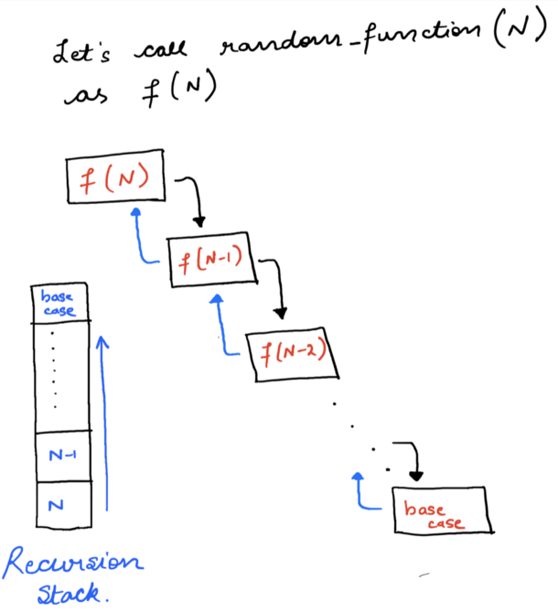
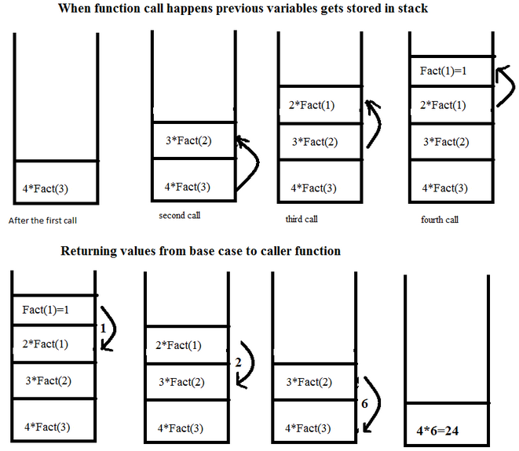
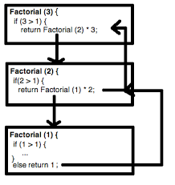
Recursion stack: factorial example

Slide 15
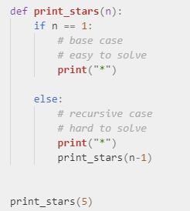
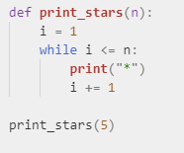
Iterative >< Recursive

Slide 16
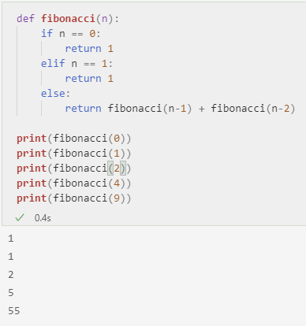
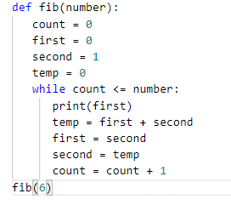
Recursive Fibonacci vs iterative

Slide 17
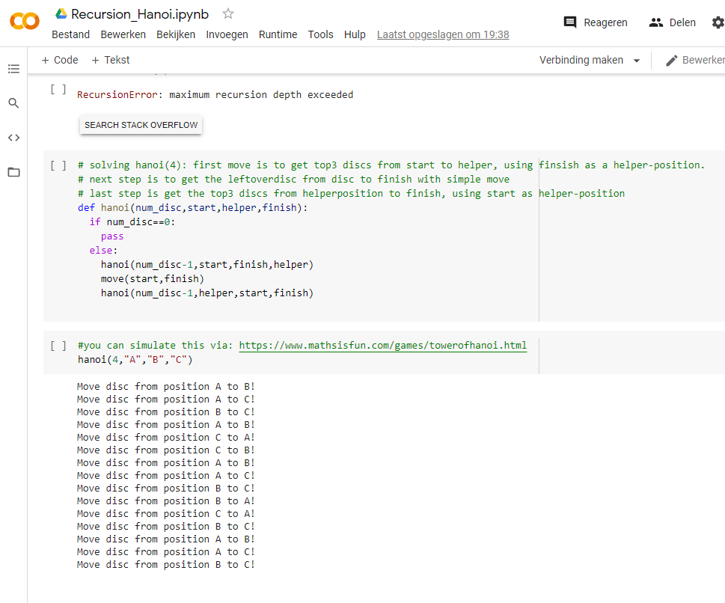
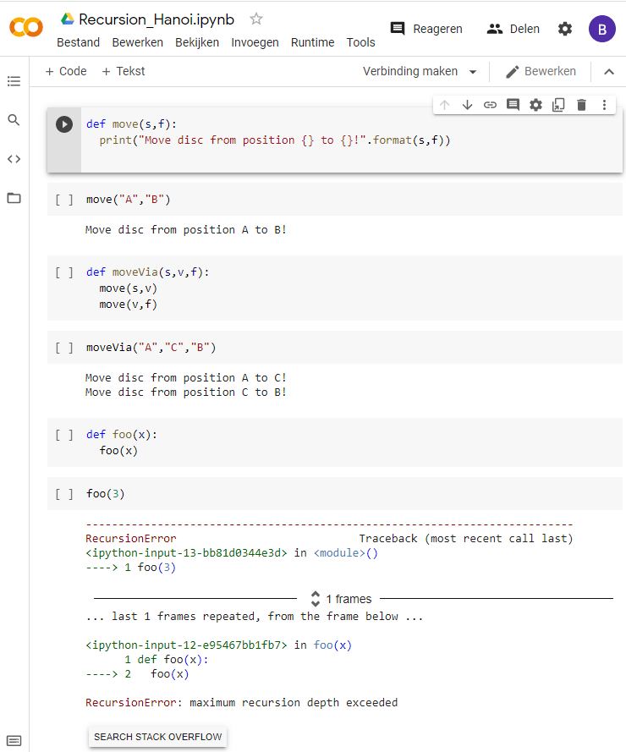
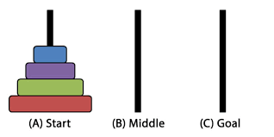
Towers of Hanoi

Slide 18
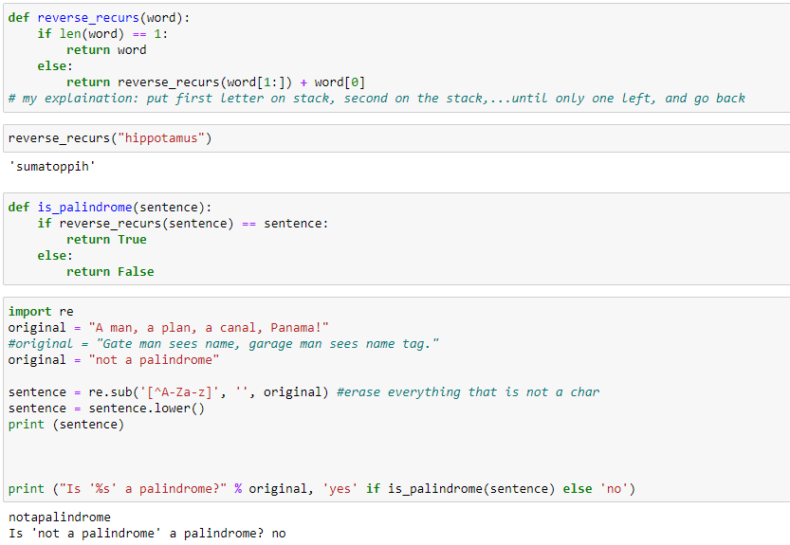
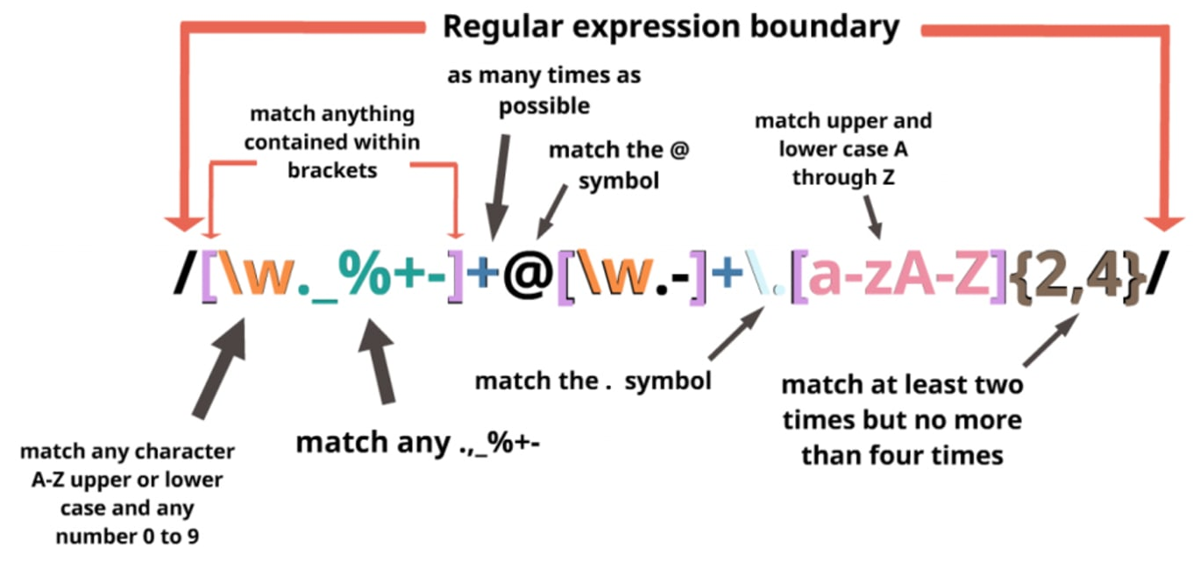
Recursion on text

Slide 19
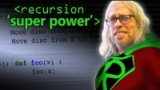
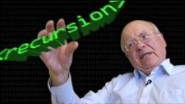
More info

Slide 20
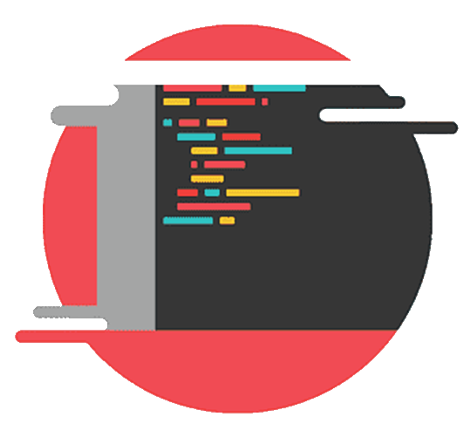


Over to you

